Slide 1
Operating system Project
1-soket and multithreading
2-shared-memory and synchronization

Slide 2
team member and coordinator
Abdlhamed Abdlrady Abass-1
Mostafa Ali Abdelsamea-2
Khalaf Hussein Khalaf-3
Ayman Mahmud Mohamed -4
Youssef Abdlrahim Abade-5
The coordinate is
Eng/ Maryam Abohurairah Abdelfattah

Slide 3
Project idea
Inter-Process Communication Using Shared Memory & Semaphores
The project demonstrates how multiple processes can communicate and synchronize with each other using Inter-Process Communication (IPC) mechanisms provided by the Operating System.
Use Shared Memory to allow processes to access a common memory space
Use Semaphores to control access to shared memory and avoid race conditions

Slide 4
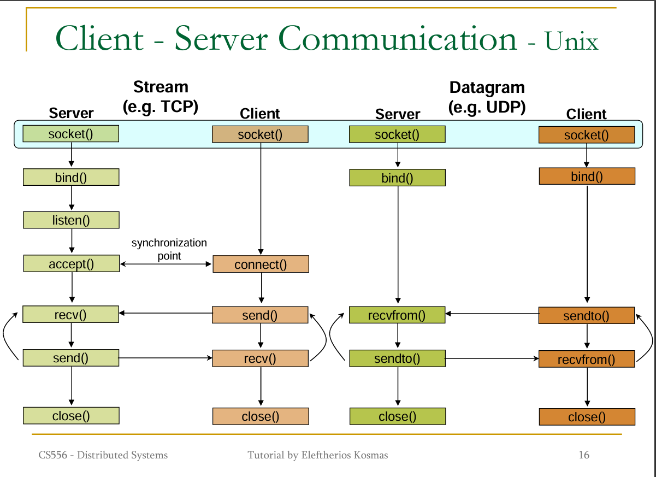
How the project work

Slide 5
soket and multithreading
in this part, sockets are used to allow communication between different users over a network.
The system is based on a client–server model where users connect to a central server.
Multithreading is used so the server can deal with more than one user at the same time.
Each user connection runs in a separate thread to keep the system responsive.
This approach helps the chat system work smoothly and exchange messages in real

Slide 6
shared-memory and synchronization
In this part, shared memory is used to allow different processes to exchange data on the same machine.
All processes access a common memory space to read and write messages.
Synchronization techniques are used to control access to the shared memory.
Semaphores help prevent conflicts when multiple processes try to access the memory at the same time.
This method provides fast and efficient communication between processes.

Slide 7
The end
Thanks for us

